Slide 1
ChatRelay
Zoheb, Kenny, Talhah

Slide 2
MESSAGE - ZOHEB
Represents individual text messages in the chat system
Tracks unique message ID via a static counter
Stores a timestamp at the time of creation, content, sender, and destination chat
Associates messages with both sender and chat room

Slide 3
USER/ABSTRACTUSER - ZOHEB
Represents an account in the system.
Stores personal data like name, username, password.
Contains unique ID.
Tracks associated chat rooms
Associates users with their conversations.

Slide 4
CHAT - ZOHEB
Represents a conversation room in the messaging system.
Stores a unique ID, room name, and list of chatters.
Supports public and private chat rooms, where privacy affects who can add new members.
Used when creating or loading chat sessions from file.
Chats hold User and Message objects.

Slide 6
KENNY’S PACKET/DBMANAGER/SERVER/CLIENTHANDLER
ZOHEB’S USER/CHAT/MESSAGE

Slide 8
TALHA’S CLIENT/GUI
ZOHEB’S USER/CHAT/MESSAGE

Slide 11
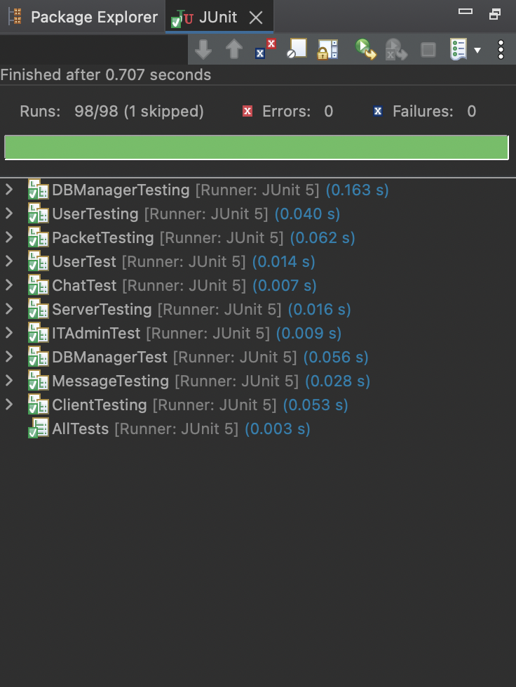
Unit Testing - Zoheb
Uses JUnit framework for automated test execution.
There exists a testing suite in AllTests.java that acts as a driver for all tests in the system.
Covers normal operations, as well as robust operations.

Slide 12
Unit Testing - Zoheb
Performed extensive Unit Testing for the following classes:
Chat
Client
DBManager
ITAdmin
Message
Packet
Server
User
* Includes test socket stubs to simulate network connections

Slide 13
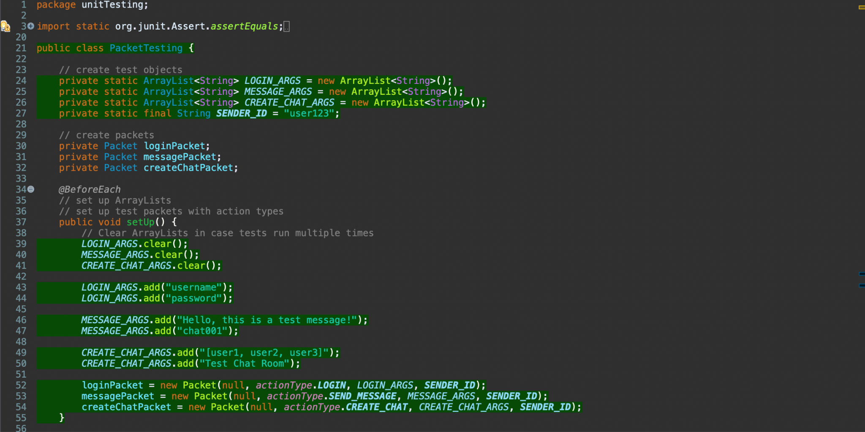
Unit Testing - Zoheb

Slide 14
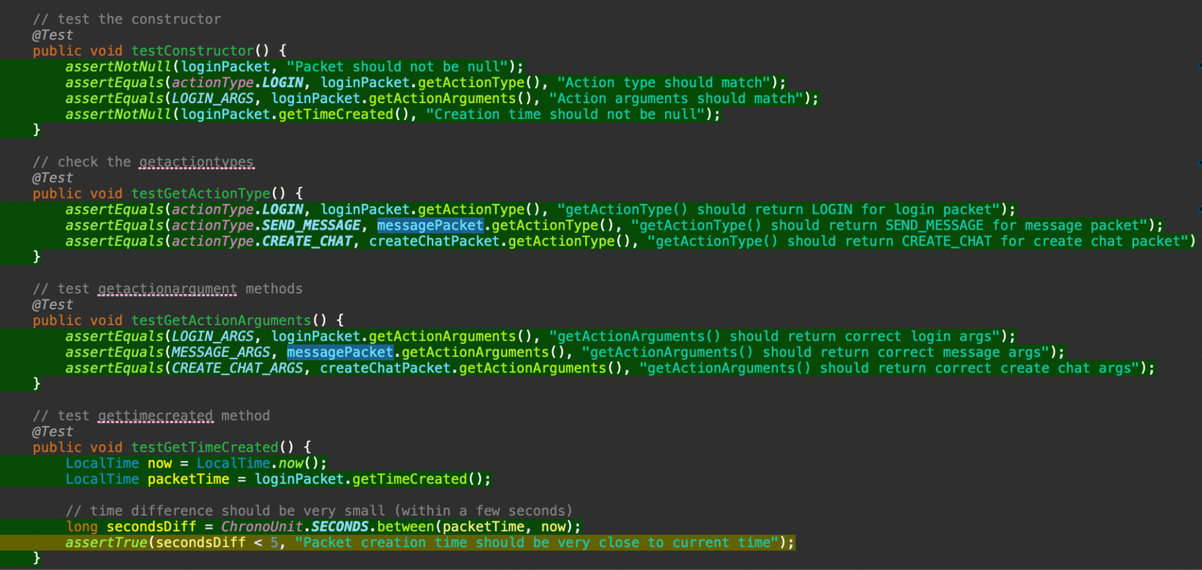
Unit Testing - Zoheb

Slide 15
OTHER

